Slide 1


CAPSTONE PROJECT
Cyber Security Threats Analysis
Presented By
Student Name: RaHUL BarDHAN
College Name: Central institute of technology kokrajhar
Department: computer science and engineering
Email ID: rahulbardhan285@gmail.com

Slide 2
OUTLINE:
Problem Statement
Proposed Solution
System Development Approach
Dashboard Development and Deployment
Result
Conclusion
Future Scope
References

Slide 3
Problem Statement:
Rapid digital transformation has increased global cyberattacks.
Cause massive financial losses, data breaches, and service disruptions.
Organizations struggle to :
Track evolving attack patterns
Identify high-risk countries and industries
Analyze attack severity and response time.
Lack of interactive visual analytics platforms makes :
- Threat monitoring difficult - Trend analysis inefficient - Strategic decision-making slow.
Result : Systems remain vulnerable to emerging cyber threats.

Slide 4
Proposed Solution:
The proposed system is an interactive Power BI "Global Cybersecurity Attack Analysis Dashboard" that transforms raw Global cybersecurity Threats (2015–2024) into actionable visual insights.
# This solution consists of the following dataset components :
Data Collection :
- Kaggle dataset “Global Cybersecurity Threats (2015–2024)”.
- Contains Attributes like Country, Threat type, Industry, Financial Impact, Severity Level, Response time.
Data Preprocessing :
- Cleaning and transform the collected data using Power Query to handle missing values, outliers and inconsistencies.
- Feature engineering to extract relevant features from the data that might impact using Power Query.
Dashboard Development :
- Developing Multi-page interactive dashboards
- using Visuals like Maps, Treemaps, Decomposition Trees and KPIs with DAX measures and AI insights.
Deployment :
- Publishing to Power BI Service with Row-Level Security (Data Level) enabled and natural-language Q&A.
Evaluation :
- Focusing on Interactivity, Performance optimization, Insight generation.

Slide 5
System Development Approach:
System Requirements :
- Power BI Desktop, CSV dataset (~3000 records), Windows / Mac with Internet access.
Tools & Technologies used :
- Power Query (ETL & data cleaning, transformation and extraction)
- DAX (custom measures & calculations)
- Power BI Visuals (Filled Map, Treemap, Decomposition Tree, Gauge, Key Influencers)
- Microsoft Copilot in Power BI (AI design & narrative generation)
- Custom teal-blue theme (matched from reference GitHub PBIX) with modified backgrounds and
Row-Level Security enabled.

Slide 6
Dashboard Deployment and Deployment :
The Dashboard Deployment and Development section describes the process of building the Power BI dashboard from the dataset using data modeling, DAX, and visualizations and then publishing it to Power BI Service with security and interactive features enabled.
Data Modeling :
- used Star-schema design for optimized performance and scalability.
Data Input :
- Country, Year, Threat Type, Attack Vector, Affected Industry, Financial Impact ($M), Severity Level, Response Time (Hours) etc.
Development Process :
- Data import, cleaning and build Relationships in Power Query. - creating DAX measures for KPIs (Total Attacks, Total Loss, YoY Growth %, Critical Attacks %). - Design of 4 interactive pages with slicers, drill-through, bookmarks, and custom theme.
Deployment Process :
- Published to Power BI Service (Shareable App). - Enabling natural language Q&A. - Enforcing Row-Level Security for controlled access.

Slide 7
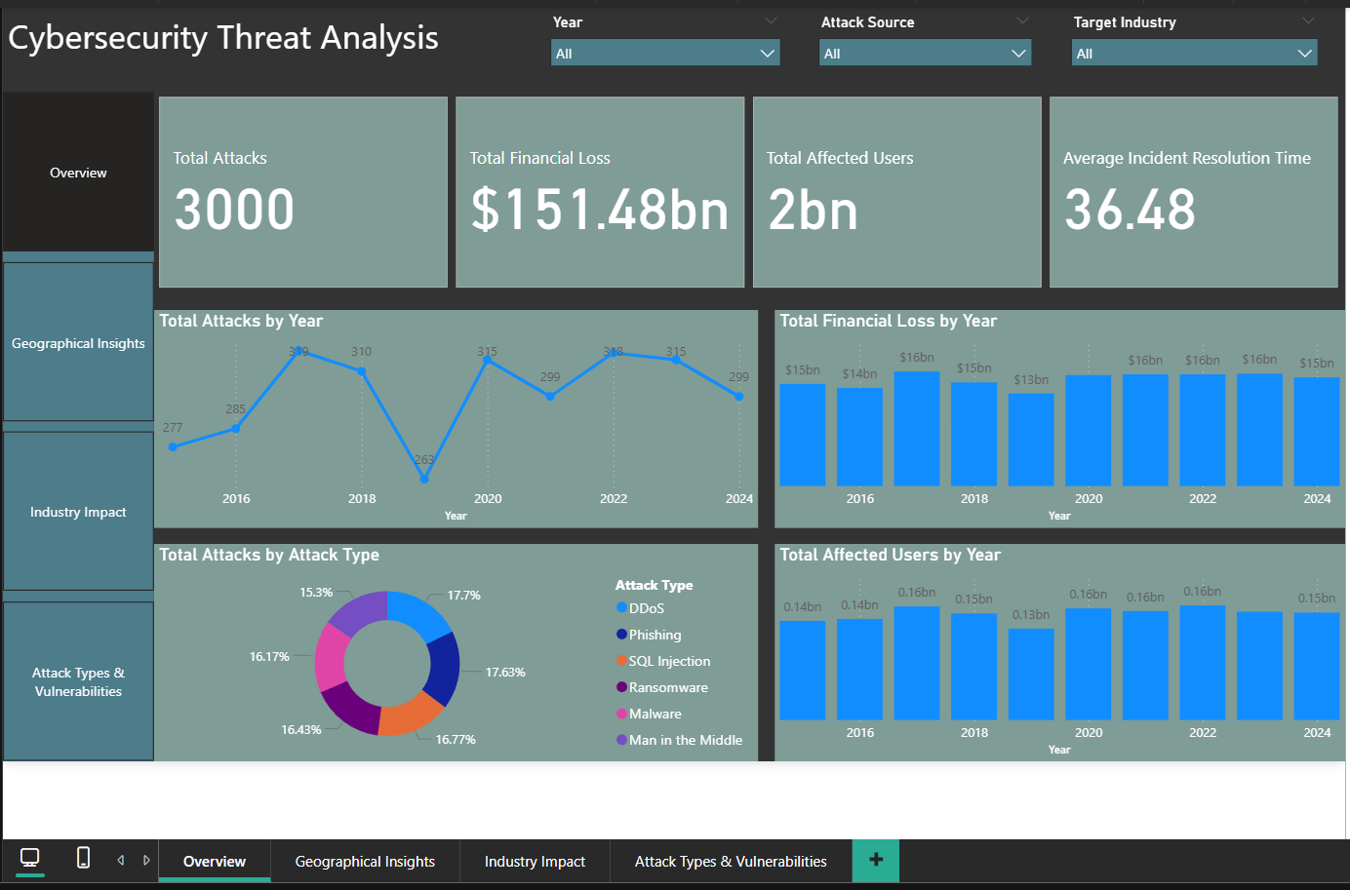
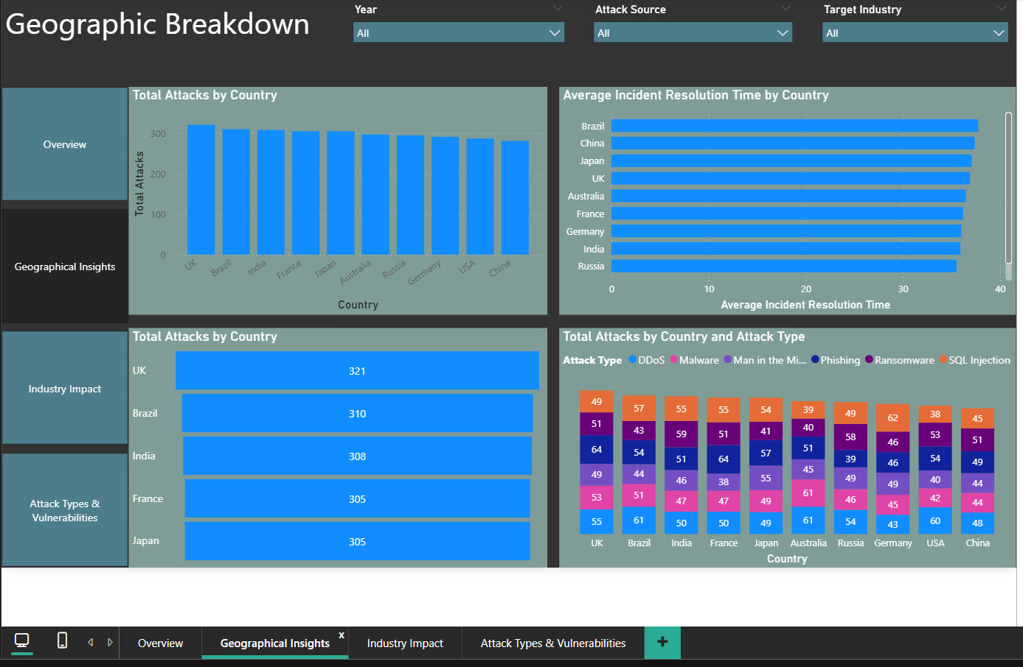
Result:
The Result section presents the final Power BI dashboard outputs (screenshots) and the key insights derived from the cybersecurity attack data analysis.
Visual Deliverables :
Picture 1: Overview
Picture 2 : Geographical Insights

Slide 8
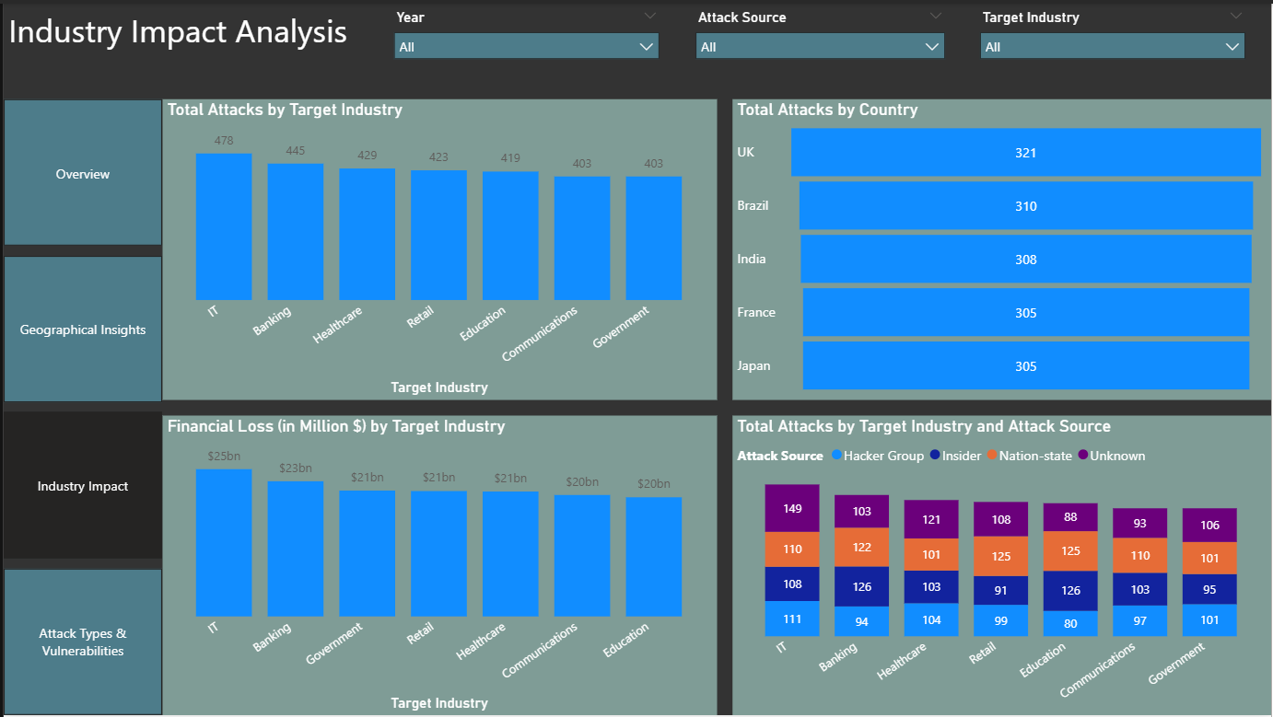
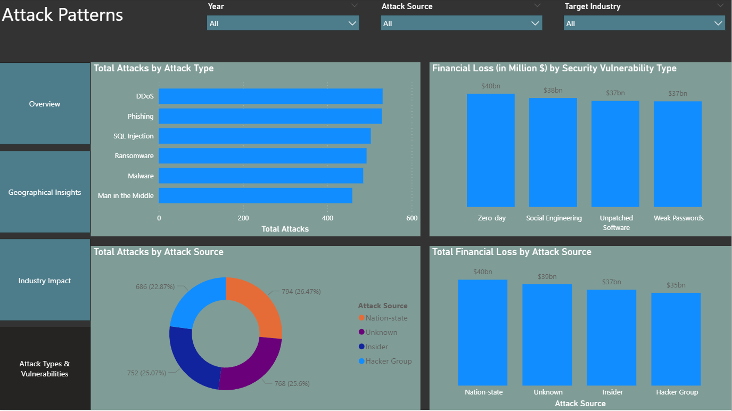
Result:
Visual Deliverables :
Picture 3: Industrial Impacts
Picture 4: Attack Types and Vulnerabilities

Slide 9
Result:
Key Insights :
Total Attacks: 2,500+
Total Financial Loss: $889.6 Billion
Top Threats types: Man-in-the-Middle, Phishing, Ransomware
High-Risk Countries: USA, China, India
Top Affected Industries: Finance & Healthcare
Avg. Response Time: 45 hours

Slide 10
Conclusion:
Achievement :
- Transformed complex threat data into a clear, interactive visual platform. - Implementation of advanced Power BI visualizations - Analytical calculations using DAX - Data security using Row-Level Security - Creation of professional cybersecurity analytics dashboard.
Business Value :
- Enhances threat awareness, trend analysis, and strategic decision-making.
Technical Success :
- Effectively resolved data standardization challenges using Power BI, DAX, and RLS.
Impact :
- Demonstrates the critical role of data visualization in modern cybersecurity analysis.

Slide 11
Future scope:
Live Integration : Real-time threat monitoring via APIs.
Predictive Analytics : Machine learning models for attack forecasting.
Scalability : Global enterprise deployment and mobile optimization.
Advanced AI: Automated anomaly detection and alert generation
Emerging Threats: Tracking AI-generated attacks and quantum computing risks.

Slide 12
References:
• Dataset: Kaggle - Global Cybersecurity Threats (2015-2024).
https://www.kaggle.com/datasets/atharvasoundankar/global-cybersecurity-threats-2015-2024
• Microsoft Power BI Documentation & Learning Path:
https://learn.microsoft.com/en-us/power-bi/
• Drive Link:
https://drive.google.com/drive/folders/17Bws-aiBggOd7uPMhQPIsc81S89qONZs?usp=sharing
• GitHub Link:
https://github.com/rahulbardhan/Cyber-Security-Threats-Analysis/tree/main

Slide 13
Thank You

